Slide 1
Statistical Analysis
Topic: Column Graph
EQ: What is a column graph and why do we use them to display data?

Slide 2
Starter Activity –
Survey class for favourite colour
Have them tally the results and create a dot plot (revision from earlier lesson)
Pose the question – what if we had 100 students in our survey?
Notes:
Teacher notes: Students are creating a dot plot with a few colours and their class size. The question seeks to link from dot plot to column graph where it will be easier to represent larger numbers against each interval or category.
You might like to have them draw a box around the dots at some stage to convert it to a column graph.
http://www.scootle.edu.au/ec/viewing/S4681/index.html is a Scootle resource with an animation of constructing column graphs.
Another resource - http://education.abc.net.au/home#!/media/1477653/

Slide 3
24
7
30
Column Graphs
Date
EQ: What is a column graph and why do we use them to display data?
Questions
Notes
Explanations
Summary

Slide 4
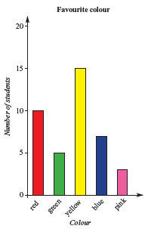
24
7
30
Column Graphs
Date
EQ: What is a column graph and why do we use them to display data?
Questions
Notes
Explanations
What is a column graph?
A column graph shows data in columns.

Slide 5
24
7
30
Column Graphs
Date
EQ: What is a column graph and why do we use them to display data?
Questions
Notes
Explanations
Favourite Colour | Count
Red | 10
Green | 5
yellow | 15
Blue | 6
Pink | 4
How do we make a column graph?
Tally the data into the categories.
Draw the axes to fit the data. Put the quantity on the y-axis and the categories on the x-axis.
Draw the columns for each category to the height equal to the value.

Slide 6
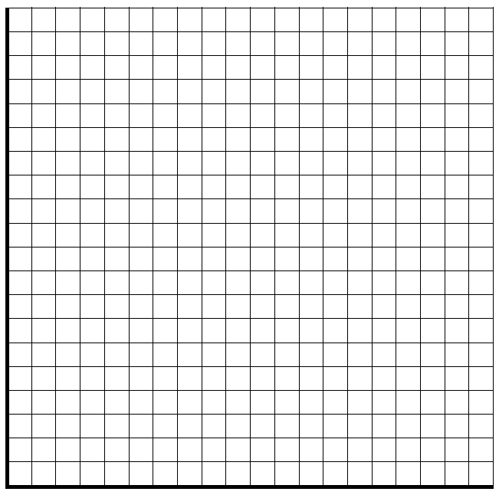
How does it work?
Favourite Colour | Count
Red | 10
Green | 5
yellow | 15
Blue | 6
Pink | 4
Notes:
You might like to use this for a demonstration

Slide 7
24
7
30
Column Graphs
Date
EQ: What is a column graph and why do we use them to display data?
Questions
Notes
Explanations
How do we read a column graph?
Look at the category then read the value from the height.
How many students prefer red?
How many students prefer pink?
How many people were surveyed?

Slide 8
Independent Practice
In small groups
Roll two dice and add the scores together and write them down
Do this 20 times
Complete a frequency table and histogram of the results
Application: Once you’ve completed your frequency table and Dot plot, calculate the following for your sample space:
The Median
The Mode
The Range
Extension:
How many times did you roll a multiple of 2?
What is the mean number you rolled?

Slide 9
Class/Homework
Worksheet or Statistics Foldable
Notes:
The Statistics Foldable works with both dot plots and histograms, so may be good to start now and add on to once we get to histograms. Or just wait until histograms, your call, Teach.

Slide 10
Player | Goals to date
Lachie Neal | 7
Nat Fyfe | 10
David Mundy | 15
Ed Langdon | 8
Brandon Matera | 11
Adam Cerra | 7
Luke Ryan | 1
On a piece of paper, create a column graph for above set of numbers.
Calculate the mean, median, mode and range for the above set of numbers
Hand in to me when done and complete summary

Slide 11
24
7
30
Column Graphs
Date
EQ: What is a column graph and why do we use them to display data?
Questions
Notes
Explanations
Complete your summary by answering the EQ
Summary
Column graphs display __________ data in ___________________.
They show ______________________________________________

Slide 12
Homework
Review Notes
List all new terms in glossary
Finish Dot Plot worksheet or Statistics Foldable

